Slide 1
Computer Architecture
A Quantitative Approach, Sixth Edition
Chapter 1
Fundamentals of Quantitative Design and Analysis
Part 2: Trends, Constraints, and Wisdom
“I think it’s fair to say that personal computers have become the most empowering tool we’ve ever created. They’re tools of communication they’re tools of creativity, and they can be shaped by their user.” – Bill Gates, February 2004

Slide 2
Acknowledgements
Thanks to many sources for slide material
© 1990 Morgan Kaufmann Publishers, © 2001-present Elsevier
Computer Architecture: A Quantitative Approach by J. Hennessy & D. Patterson
© 1994 Morgan Kaufmann Publishers, © 2001-present Elsevier
Computer Organization and Design by D. Patterson & J. Hennessy
© 2002 K. Asinovic & Arvind, MIT
© 2002 J. Kubiatowicz, University of California at Berkeley
© 2006, © 2010 No Starch Press for Inside the Machine by J. Stokes
© 2007 W.-M. Hwu & D. Kirk, University of Illinois & NVIDIA
© 2007-2010 J. Owens, University of California at Davis
© 2010 CRC Press for Introduction to Concurrency in Programming Languages by M. Sottile, T. Mattson, and C. Rasmussen
© 2017, IBM POWER9 Processor Architecture by Sadasivam et al., IBM
© 2016, © 2019 POWER9 Processor User’s Manual, IBM
© The OpenPOWER Foundation

Slide 3
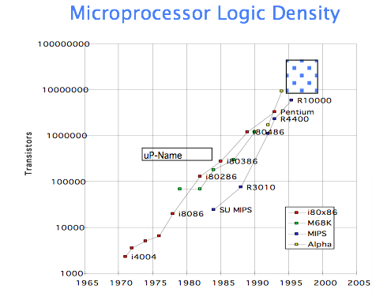
Technology
Workstations, PCs, etc. have been riding this wave since.
In the mid-1980s, the single-chip processor (32-bit) and the single-board computer emerged.
DRAM Chip Capacity
1980 64 kB
1983 256 kB
1986 1 MB
1989 4 MB
1992 16 MB
1996 64 MB
1999 256 MB
2002 1 GB
2005 4 GB

Slide 4
Technology Rates of …
Processor
Logic Capacity: ~30% per year
Clock Rate: ~20% per year (2003-2011);
~10% per year (2011-2015); ~3% per year (2015-now) … why?
Memory
DRAM Capacity: ~60% per year (4x every 3 years)
Memory Speed: ~10% per year
Cost Per Bit: Improves ~25% per year
Disk
Capacity: ~60% per year
Total Use of Data: ~100% per 9 months!
Network
Bandwidth: 100%+ per year
Notes:
What are the implications of computing capability increasing faster than memory speed?

Slide 5
Execution Time
Time = Clock Speed * CPI * Instruction Count
= seconds/cycle * cycles/instr * instrs/program
= seconds/program
Execution time is the only reliable measure of computer performance.

Slide 6
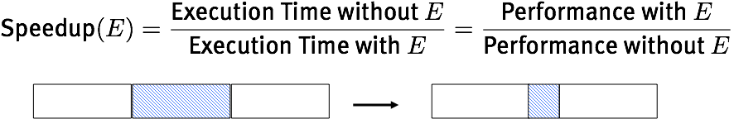
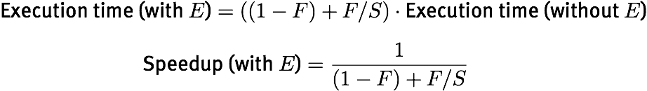
What is Amdahl’s Law?
Speedup due to enhancement E
Suppose enhancement E accelerates a fraction F of the computation by a factor of S
Notes:
Design Principle: Make the common case fast!

Slide 7
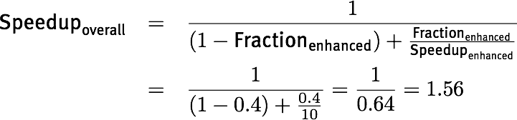
Just How Fast is “Fast”?
New CPU comes out that is a whopping 10x faster
Assume an I/O-bound server where 60% of time waits for I/O
Don’t get “wow”-ed by 10x faster. It’s only 1.56x faster in this case.

Slide 8
If we build a new architecture, how do we tell how good it is?
Notes:
FINISH THIS SLIDE DECK TODAY!

Slide 9
Basis of Architectural Evaluation
Approach | Pros | Cons
Actual Target Workload | Representative | Very specific Non-portable Difficult to run or measure Hard to identify cause
Full Application Benchmarks | Portable Widely used Improvements useful in reality | Less representative
Small “kernel” benchmarks | Easy to run Early in design cycle | Easy to “fool”
Microbenchmarks | Identify peak capability & potential bottlenecks | “Peak” may be a long way from application performance
Dwarfs* → Motifs (e.g., OpenDwarfs) | ? | ?
* See “The Landscape of Parallel Computing Research: A View from Berkeley,” December 2006.
Notes:
TEST QUESTION!

Slide 10
Evaluating Instructions
Design-Time Metrics → Productivity
Can it be implemented? In how much time? At what cost?
Can it be programmed? Ease of compilation?
Static Metrics → Efficiency
How many bytes does the program occupy in memory?
Dynamic Metrics → Efficiency/Performance
How many instructions are executed?
How many bytes does the processor fetch to execute the program?
How many clocks are required per instruction?
How “lean” a clock is practical?
Best Metric for Computer Architecture?
Time to execute the program!
CPI
Instr.
Count
Cycle
Time
Notes:
Productivity
Efficiency
Efficiency/Performance
Performance

Slide 11
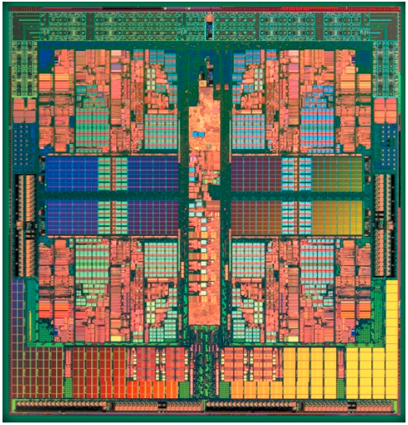
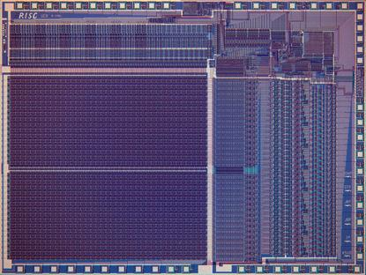
RISC “Revolution”
Questions
How did this “revolution” come about?
What happened to the revolution?
x86 instruction set architecture (ISA)
single-issue, five-stage pipelined, 32-bit microprocessors.

Slide 12
RISC: MIPS Instruction Set
32-bit fixed format inst (3 formats)
32 32-bit GPR (R0 contains zero); 32 FP registers (and HI LO)
partitioned by software convention
3-address, reg-reg arithmetic instr.
Single address mode for load/store: base+displacement
no indirection, scaled
16-bit immediate
Simple branch conditions
compare against zero or two registers for =,≠
no integer condition codes
Delayed branch
execute instruction after a branch (or jump) even if the branch is taken
compiler can fill branch delay slot ~50% of the time
Notes:
16-bit immediate plus LUI

Slide 13
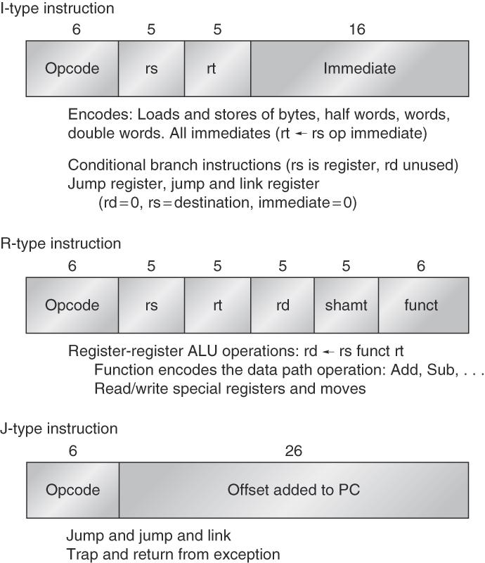
RISC Philosophy
Instructions all same size
Small number of opcodes (small opcode space)
Opcode in same place for every instruction
Simple memory addressing
Instructions that manipulate data don’t manipulate memory, and vice versa
Minimize memory references by providing ample registers
Implications to pipelining?

Slide 14
What is pipelining?

Slide 15
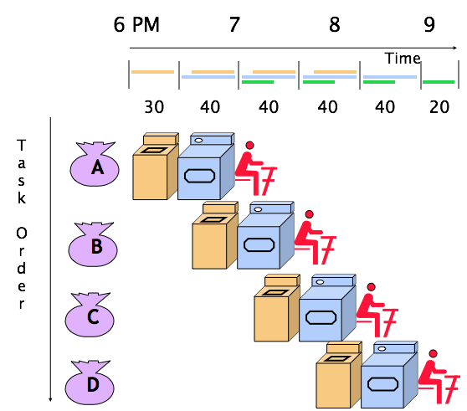
Pipelining Review
Pipelining does NOT help latency of a single task, it helps throughput of entire workload
Pipeline rate limited by slowest pipeline stage
Multiple tasks run simultaneously using different resources
Potential speedup =
number of pipe stages
Unbalanced lengths of pipe stages reduces speedup
Time to “fill” pipeline and time to “drain” it reduces speedup
Stall for dependencies

Slide 16
Conventional Pipelined Execution
time
IF | ID | EX | MEM | WB
 | IF | ID | EX | MEM | WB
 |  | IF | ID | EX | MEM | WB
 |  |  | IF | ID | EX | MEM | WB
 |  |  |  | IF | ID | EX | MEM | WB
 |  |  |  |  | IF | ID | EX | MEM | WB
program
flow

Slide 17
Pipelined Architecture
Time (Clock Cycles)
Cycle 1
Cycle 2
Cycle 3
Cycle 4
Cycle 5
Cycle 6
Cycle 7
Cycle 8
IF
ID
EX
MEM
WB
IF
ID
EX
MEM
WB
Instruction Order
IF
ID
EX
MEM
WB
IF
ID
EX
MEM
WB

Slide 18
Why MIPS is “Awesome”
All MIPS instructions same length
Source registers located in same place for
every instruction
Overlap register fetch & instruction decode
Simple memory operations
MIPS: execute calculates memory address, memory load/store in next stage
X86: can operate on result of load: execute calculates memory address, memory load/store in next stage, THEN ALU stage afterwards
All instructions aligned in memory — one access for each instruction
Notes:
Anecdote: Is MIPS gone? No. Chinese licensed it and are putting together their own chip for supercomputing.

Slide 19
Limits to Pipelining
Hazards prevent next instruction from executing during its designated clock cycle
Structural hazards: Two instructions attempt to use the same hardware to do two different things at once
Data hazards: Instruction depends on result of prior instruction still in the pipeline
Control hazards: This is caused by the delay between the fetching of instructions and decisions about changes in control flow (branches and jumps).

Slide 20
Focus on the Common Case
Common sense guides computer design
In making a design trade-off, favor the frequent case over the infrequent case, e.g.,
Instruction fetch and decode unit used more frequently than multiplier, so optimize it first
If database server has 50 disks/processor, storage dependability dominates system dependability, so optimize it first
Frequent case is often simpler and can be done faster than the infrequent case, e.g.,
Overflow is rare when adding two numbers, so improve performance by optimizing common case of no overflow
What is the frequent case and how much performance improved by making case faster?
Amdahl’s Law
Notes:
May slow down overflow, but overall performance improved by optimizing for the normal case → isn’t this the way caches work?

Slide 21
What is the memory hierarchy? (Why does a memory hierarchy exist?)

Slide 22
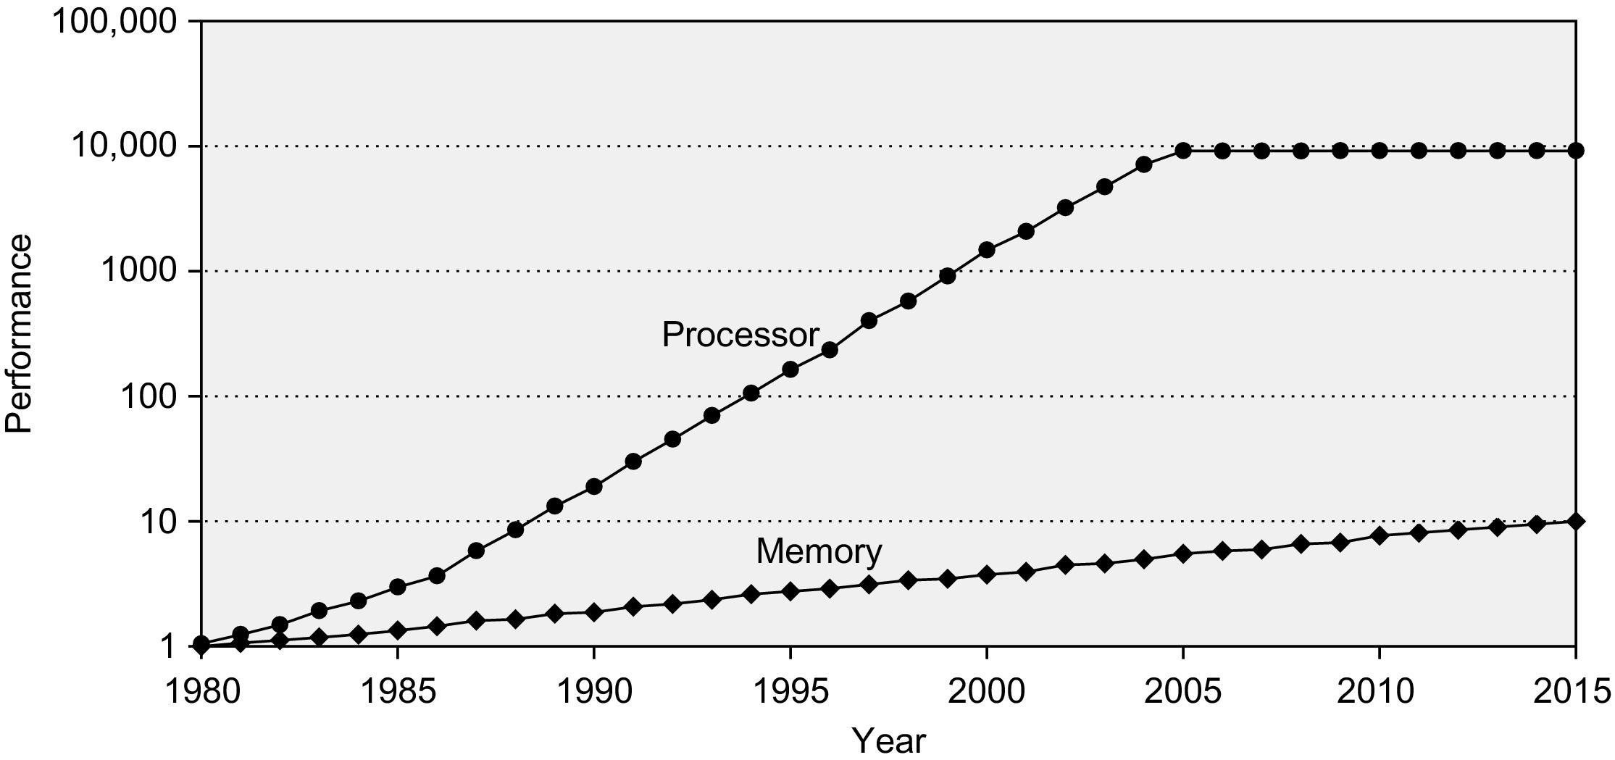
Why Care about Memory?
POWER WALL
CPU 60% per year OR 2x per 1.5 years
Gap grows by 50% → MEMORY WALL
DRAM 9% per year OR 2x per 10 years

Slide 23
Memory Levels
Capacity
Access-Time Cost
Staging
Transfer Unit
CPU Registers
100s bytes (B)
< 2 ns
Registers
faster
instr. operands
program/compiler
1-8 bytes
Cache
kB SRAM
2-100 ns
$0.01-$0.001/bit
Cache
blocks
cache controller
8-128 bytes
Main Memory
GB DRAM
100 ns – 1000 ns
$0.01-$0.001/bit
Memory
pages
OS
512-4k+ bytes
Disk
TB
10 ms – 40 ms
$0.001-$0.0001/bit
Disk
files
user/operator
MB – GB
Tape
“infinite”
sec – min
$0.000001/bit
Tape
larger

Slide 24
Memory Hierarchy
The Principle of Locality
Program access a relatively small portion of the address space at any instant of time
Temporal Locality: Locality in Time
Spatial Locality: Locality in Space
Three Major Categories of Cache Misses
Compulsory Misses: cannot avoid
Example: cold start misses
Conflict Misses: increase cache size and/or associativity
Capacity Misses: increase cache size
Notes:
Compulsory misses: Those misses caused by the first reference to a location in memory. Cache size and associativity make no difference to the number of compulsory misses. Prefetching can help here, as can larger cache block sizes (which are a form of prefetching). Compulsory misses are sometimes referred to as cold misses.
Capacity misses: Those misses that occur regardless of associativity or block size, solely due to the finite size of the cache. The curve of capacity miss rate versus cache size gives some measure of the temporal locality of a particular reference stream.
Conflict misses: Those misses that could have been avoided, had the cache not evicted an entry earlier. Conflict misses can be further broken down into mapping misses, that are unavoidable given a particular amount of associativity, and replacement misses, which are due to the particular victim choice of the replacement policy.

Slide 25
Cost of Fabrication
Rock’s Law: Cost of fabs double every 4 years
$3B for fab in 2008-2009
Rise of fabless design houses (AMD now fabless)
Rise of for-hire fabs (TSMC, etc.)
$3B fab means $6B in revenue is required
Notes:
The top 5 sales leaders for fabless companies in 2003 were:
Rank Company Country of origin Revenue (million US$)
1 Qualcomm USA 2,398
2 NVIDIA USA 1,716
3 Broadcom USA 1,610
4 ATI Technologies Canada 1,401
5 Xilinx USA 1,300
The top 5 sales leaders for fabless companies in 2011 were:[8]
Rank Company Country of origin Revenue (million US$)
1 Qualcomm USA 9,910
2 Broadcom USA 7,160
3 AMD USA 6,568
4 Nvidia USA 3,939
5 Marvell USA 3,445

Slide 26
Wisdom: Where is Computer Architecture Going?

Slide 27
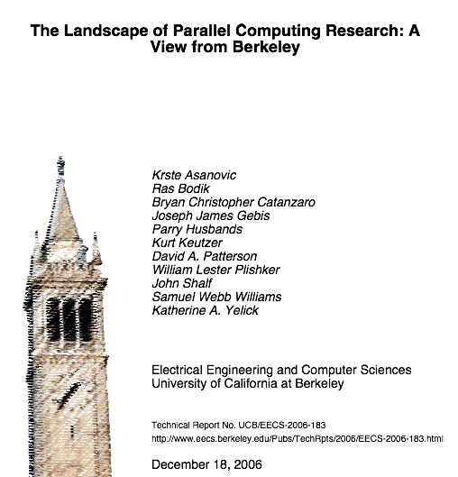
Looking to the Future

Slide 28
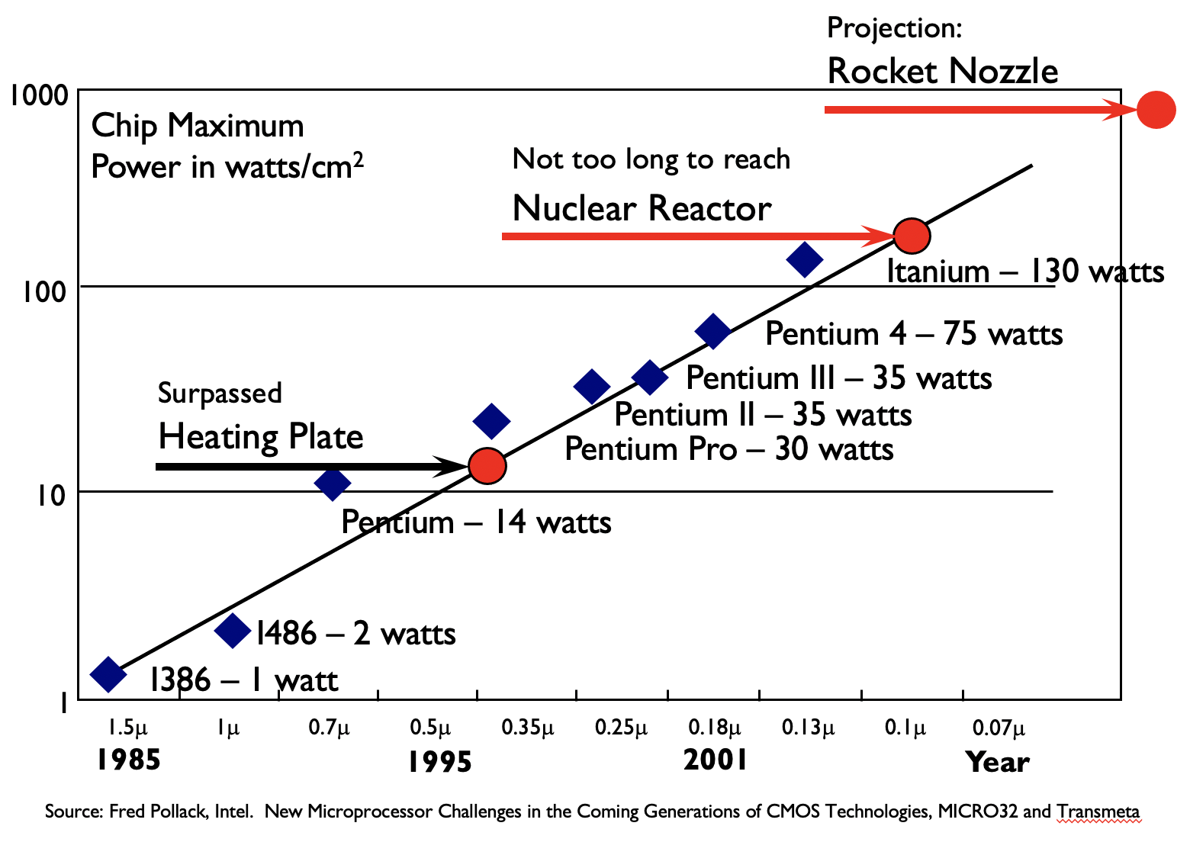
Power
Old Conventional Wisdom (CW)
Power is free, but transistors are expensive.
New CW is the “Power Wall”
Power is expensive, but transistors are free. We can put more transistors on a chip than we have power to turn on.

Slide 29
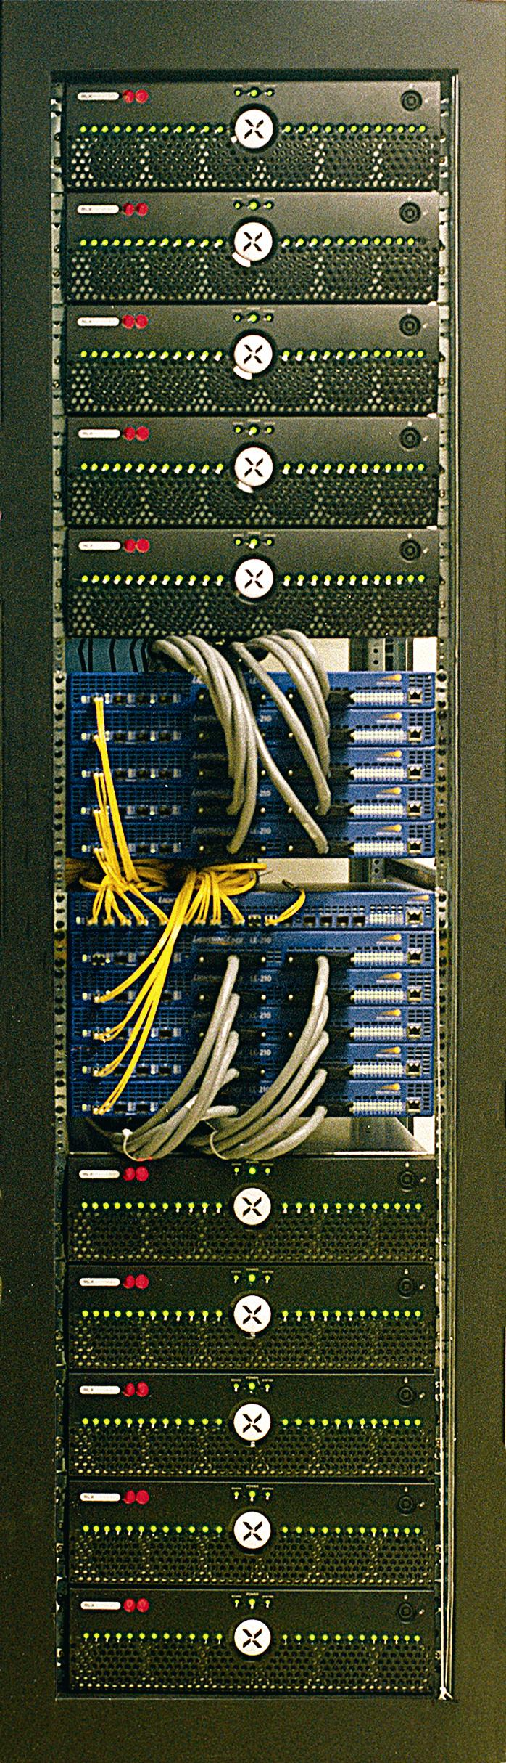

Green Destiny Supercomputer
(circa December 2001 – February 2002)
A 240-Node Cluster in Five Sq. Ft.
Each Node
1-GHz Transmeta TM5800 CPU w/ High-Performance Code-Morphing Software running Linux 2.4.x
640-MB RAM, 20-GB hard disk, 100-Mb/s Ethernet
Total
240 Gflops peak (LINPACK: 101 Gflops in March 2002.)
150 GB of RAM (expandable to 276 GB)
4.8 TB of storage (expandable to 38.4 TB)
Power Consumption: Only 3.2 kW (diskless)
Reliability & Availability
No unscheduled downtime in 24-month lifetime.
Environment: A dusty 85-90°F warehouse!
Equivalent LINPACK to a
256-CPU SGI Origin 2000
(On the TOP500 List at the time)
Featured in The New York Times, BBC News, and CNN.
Now in the Computer History Museum.
Notes:
This is a good place to explain the architecture of Green Destiny.
Each chassis has 24 nodes.
Each chassis is connected to a 24-port switch.
Each 24-port switch is connected to a “root” switch.
Despite operating in an 85-90 F dusty warehouse at 2195 meters (7400 feet) with no air conditioning, no air ventilation, no air humidification, and no air filtration.

Slide 30
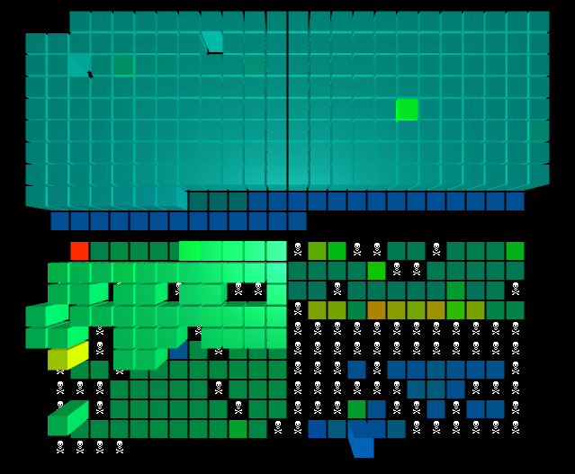
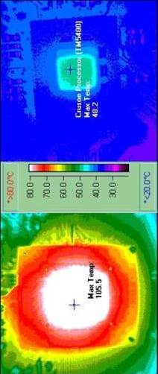
Green Destiny: Low-Power Supercomputer
Only Difference? The Processors
March 2007
Green Destiny “Imitation”: Traditional Supercomputer
Notes:
Thermal die image: 48-degree C vs. 106-degree C.

Slide 31
Compute vs. Memory
Old CW
Multiply is slow, but load and store from/to memory is fast.
New CW
The Memory Wall.
Load and store is slow, but multiply is fast.
Modern microprocessors can take 100 clock cycles to access dynamic random-access memory (DRAM), but even floating-point multiplies may take only four clock cycles.
Notes:
Power Wall + Memory Wall + ILP = Brick Wall

Slide 32
Evolution of Computation
20 years ago: computation expensive, wires free
To first order: ignore wire delay
Light moves 1 foot/ns in vacuum
Wires are also getting thinner
Wire delay now significant even on chip!
Moore’s Law implies
Computation gets cheaper
Speed of light doesn’t change
Compute don’t communicate!

Slide 33
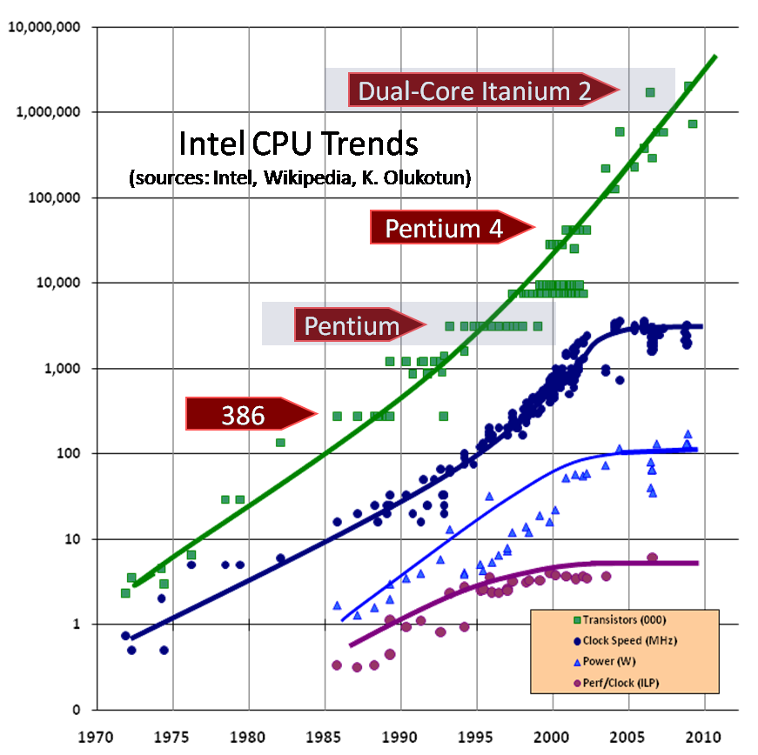
Intel Finally “Gets It” …
Intel Developer Forum, September 2004
“What Intel announced at this IDF was no less than a total rethinking of their approach to microprocessors.”
Performance improvement from Moore’s Law performance scaling will come not from increases not in MHz ratings but in machine width.
Power wall
Threading
MIPS/watt instead of MIPS
Datasets are growing in size and so are the network pipes that connect those datasets.
Intel claimed “doubling of digital data every 18 months”
More integration?
http://arstechnica.com/articles/paedia/cpu/intel-future.ars/1

Slide 34
Instruction Level
Old CW: We can reveal more instruction-level parallelism (ILP) via compilers and architecture innovation.
Examples from the past include branch prediction, out-of-order execution, speculation, and Very Long Instruction Word (VLIW) systems.
This CW will be approximately the first 5 weeks of the semester.
New CW is the “ILP wall”: There are diminishing returns on finding more ILP.

Slide 35
Trends
ILP
Notes:
3:15
-By mid-2000s, we could no longer scale clock rates at same rate.
-As shown here, e.g., dual-core CPUs in 2006 with flattened out clock speeds, power, and perf/clock.
H. Sutter, “The Free Lunch Is Over: A Fundamental Turn Toward Concurrency in Software,” Dr. Dobb’s Journal, 30(3), March 2005. (Updated August 2009.)

Slide 36
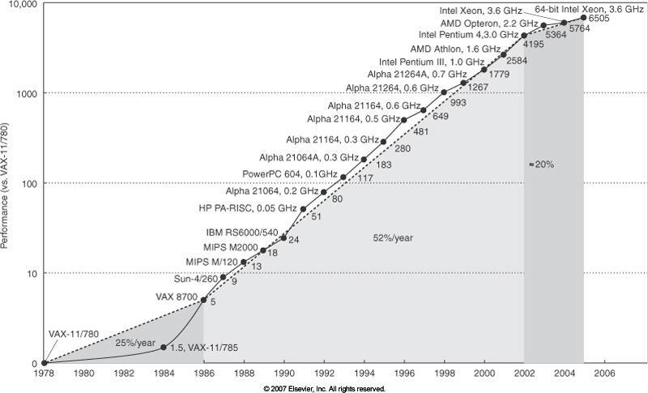
Uniprocessor
Old CW
Uniprocessor performance doubles every 18 months.
New CW
Power Wall + Memory Wall + ILP Wall = Brick Wall.
In 2006, performance is a factor of three below the traditional doubling every 18 months that we enjoyed between 1986 and 2002.
The doubling of uniprocessor performance may now take 20 years.
Notes:
TEST QUESTION!

Slide 37
On the Evolution of Computer Architecture Wisdom
Old CW: Don’t bother parallelizing your application, as you can just wait a little while and run it on a much faster sequential computer.
New CW: It will be a very long wait for a faster sequential computer.
Old CW: Increasing clock frequency is the primary method of improving processor performance.
New CW: Increasing parallelism is the primary method of improving processor performance.
Old CW: Less than linear scaling for a multiprocessor application is failure.
New CW: Given the switch to parallel computing, any speedup via parallelism is a success.

